Slide 1
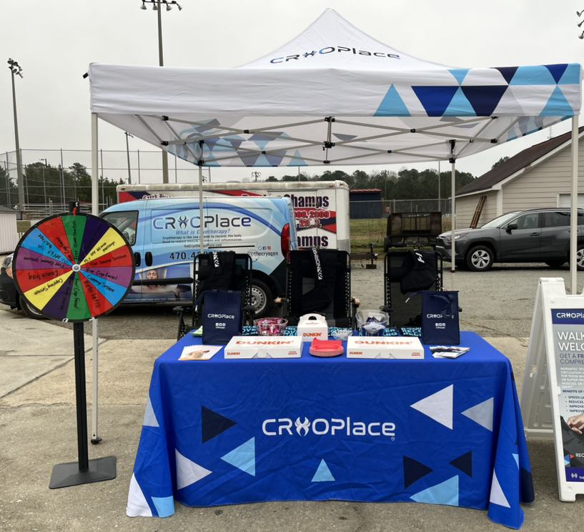
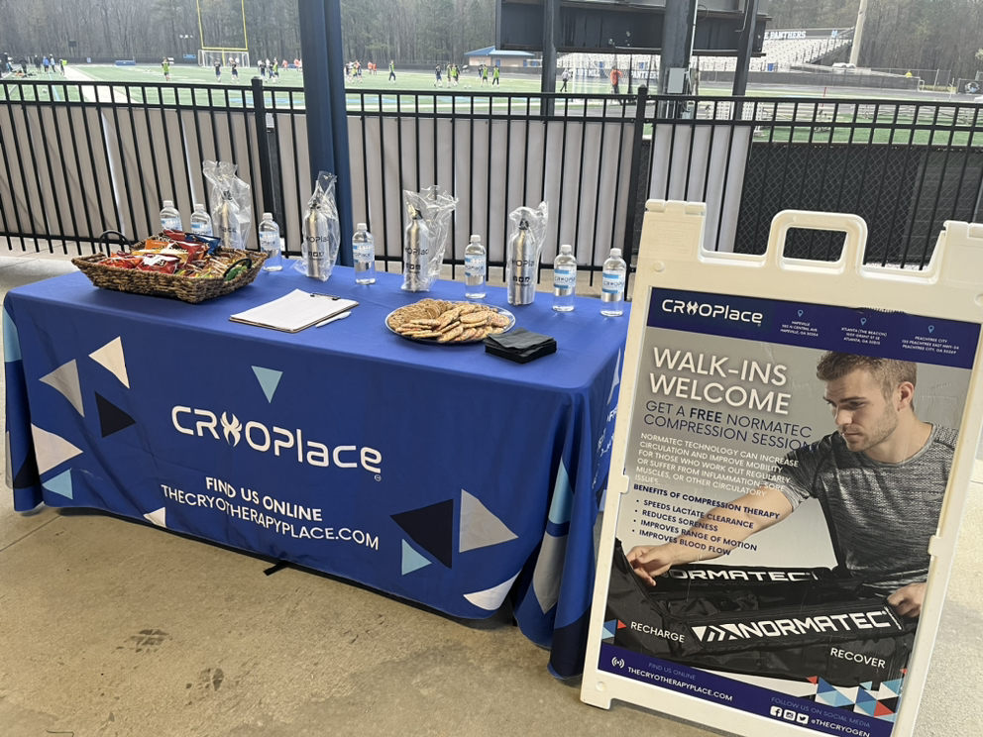
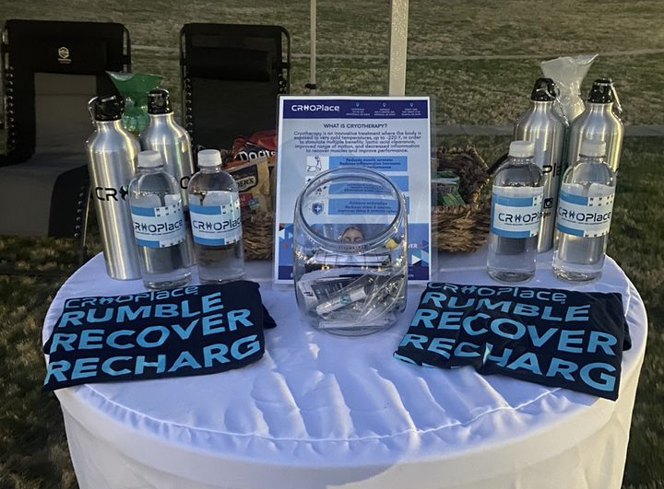
POP UPS
Keys to a Successful Pop Up

Slide 2
PREWORK
Prior to the popup there are key preparations to consider;
  to prepare for a pop up for the CryoPlace we carefully load the truck, verify the marketing materials, confirm the site details (parking, loading entrance, etc.), and confirm transportation of the CryoPlace equipment (who is driving the van, etc.).

Slide 3
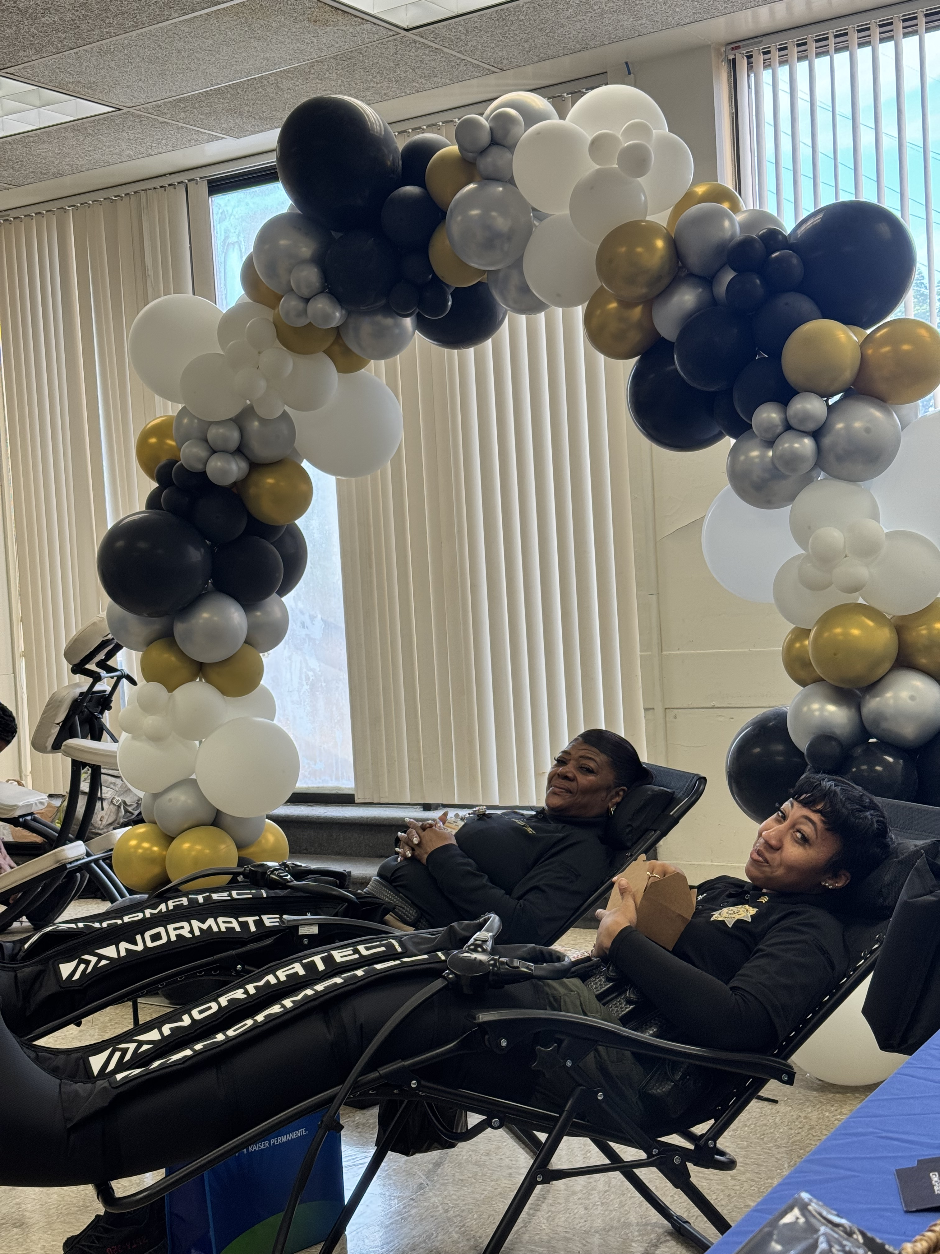
Key Components
Smile at every attendee within 3 feet of The CryoPlace setup
Smiling will influence the attendee in a positive way and make them more amendable to a sales pitch or making a purchase when you present to them.

Slide 4
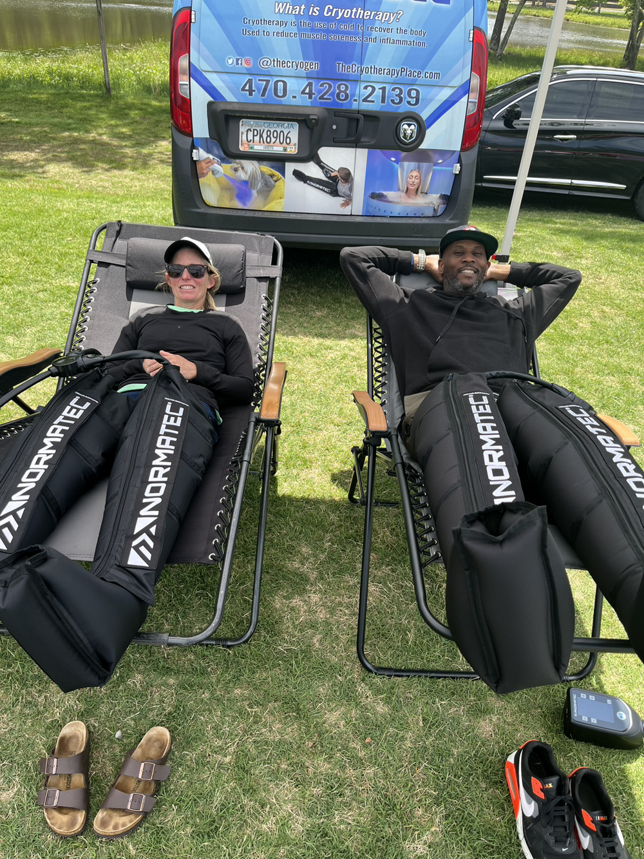
Key Components
Invite the attendee closer and inform them of all CryoPlace services offered, including where we are located and hours of operation
It’s best to stand in front of the displays and not sit when presenting this information. Standing allows you to sound clearer, more confident, and appear more relaxed.

Slide 5
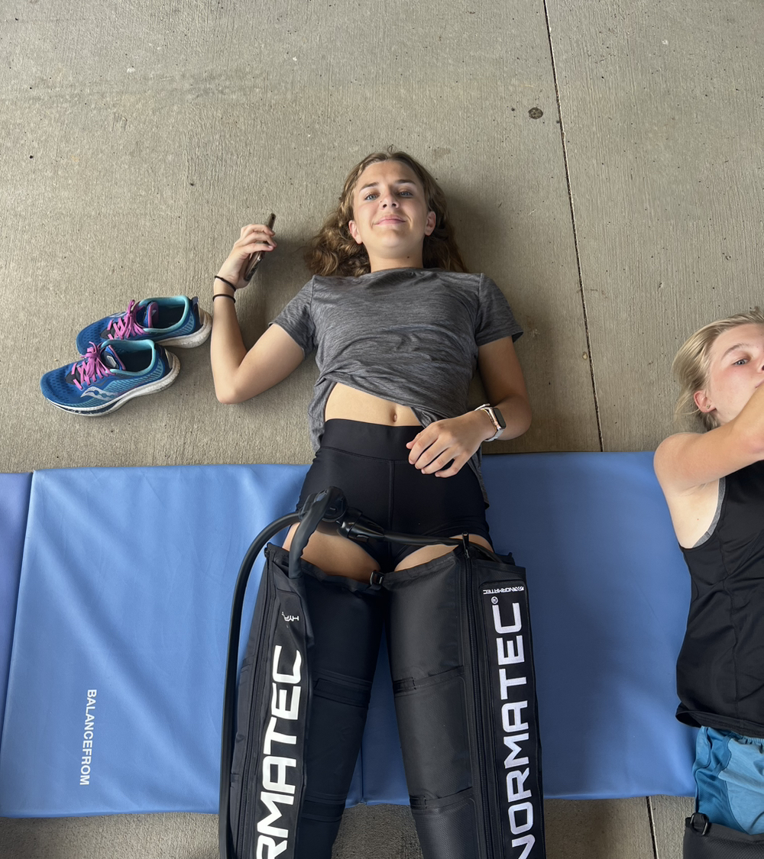
Key Components
Ask attendee to try a first-time, free compression (unless contraindicated for them):
Here is where you would tell the story and explain what compression therapy feels like. Here’s an example…”The boots feel like a massage. And like a massage there are levels. If you like a deep tissue massage we can start at a 7 but if you like a light touch we can start at a 1 or anywhere in between, What type of massage would you like?”

Slide 6
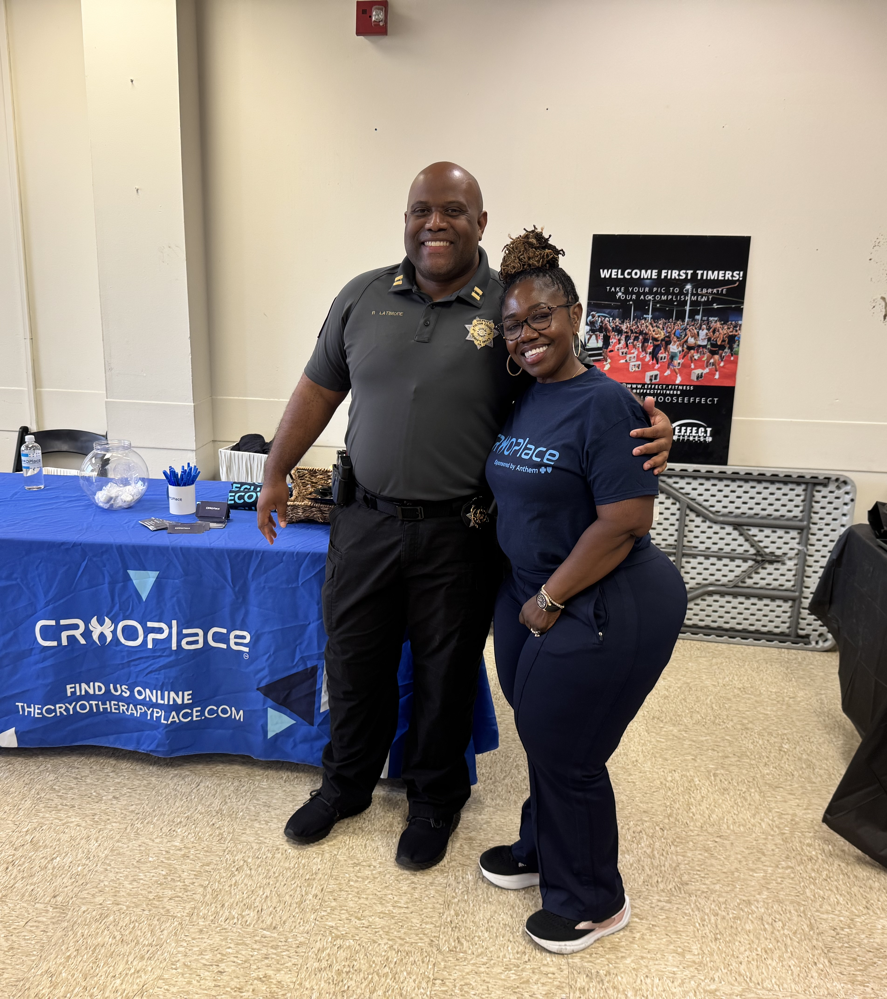
Key Components
Inform attendee of any special event offerings i.e. raffle prize, spin wheel, and the access pass.
Attendees LOVE free items. In addition to bringing out the compression boots, we will often bring snacks, raffle prizes to restaurants, t-shirts, water bottles, lunch bags, and our spin wheel for free services. Spin wheels and candy are a great attraction to use when we are attending pop ups with children.

Slide 7
Key Components
Be present; Be a part of the event and avoid sitting waiting on the clock or scrolling on the phone.
01
Be aware by watching the normatec screen for time and errors.
Take LOADS of participant pictures and post to the Cryoplace groupme.
02
Be careful with the equipment; Depress the release completely before beginning to pull the hose. Transport the equipment with care. Do not drop the hose or brain. Be aware of the zipper.
03
Share the device website with anyone that inquires about having equipment at home and tell them to text us at 855-CryoNow for the link.
04

Slide 8
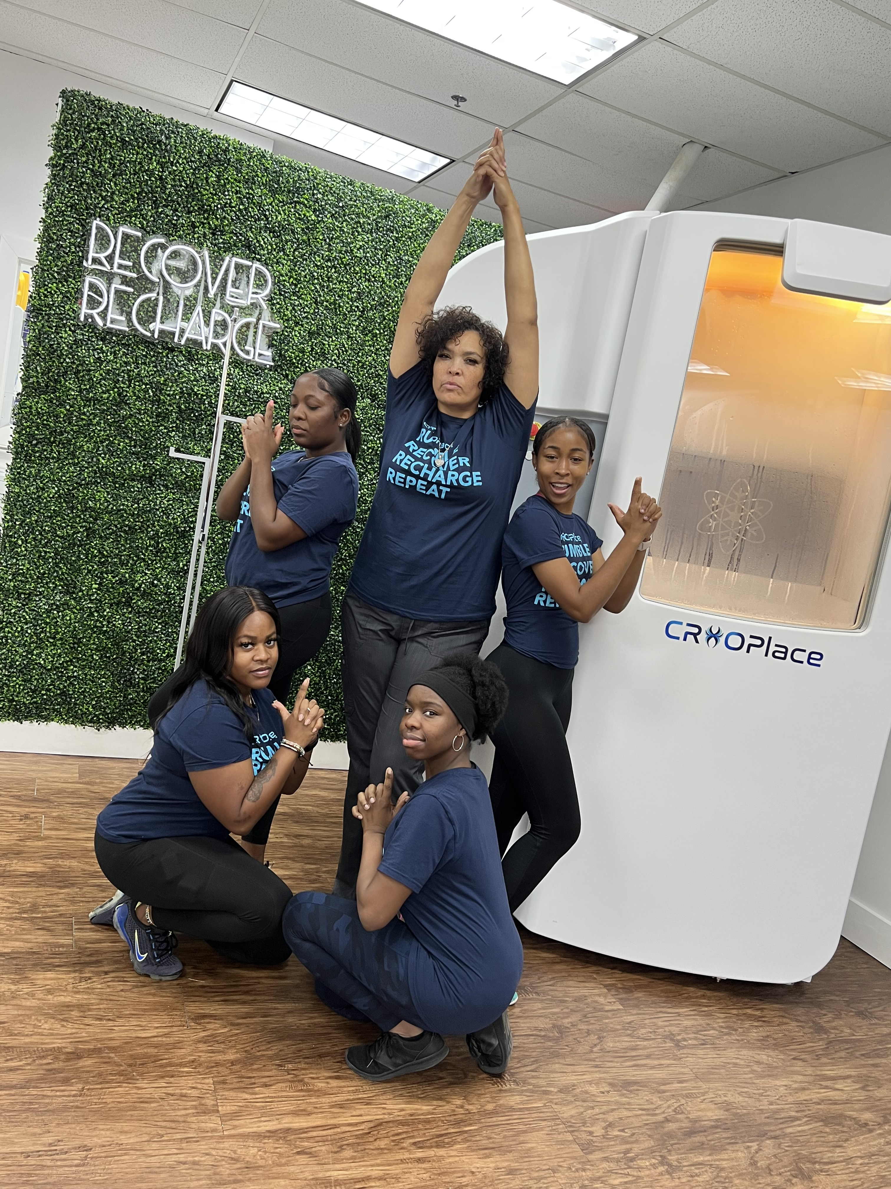
Pop Up Contest
Every Event:
  Each employee will receive an attendance bonus for being 15 minutes early for the event.
  Each employee will receive an additional bonus for equipment loading and unloading.
  The employee that post the most creative media to the Cryoplace groupme will receive an additional bonus.

